Slide 1
Revised Data Analysis Texas Precipitation Gradient (2017)
For PeerJ revision
By Sean Kinard

Slide 2
While it is useful to include many environmental variables for the sake of orientation to the survey region and transparency, the limited number of sample sites (only ten in this study) will require few variables to be evaluated using regression and multivariate methods. So, I will report all variables in a site x environment matrix as an appendix and include a more thorough introduction to subtropical basin and stream characteristics in the methods. Then I will proceed with a limited number of interpretable variables selected to evaluate climate, hydrologic, water quality, and local habitat features as drivers of community assembly.
A-piori variable selection for regression and ordinations
7 variables to evaluate with community diversity metrics and community composition ordinations
Precipitation: Annual precipitation (30-year average)
Flood disturbance regime: flash index
Drought disturbance regime: Low Flow Pulse Percent
Biogenic Pollutants: NH4+
Osmotic stressors: Conductivity
Canopy effects: Canopy Coverage
Stream morphology: Rosgen index
Use PCA to discern patterns in environmental variation among sites.
Use linear regressions to identify significant correlations with fish and invertebrate community diversity.
Use multivariate regressions to create predictive models for fish and invertebrate community diversity.
Use PCoA ordinations to visualize patterns in community composition and identify coincidental environmental predictors

Slide 3
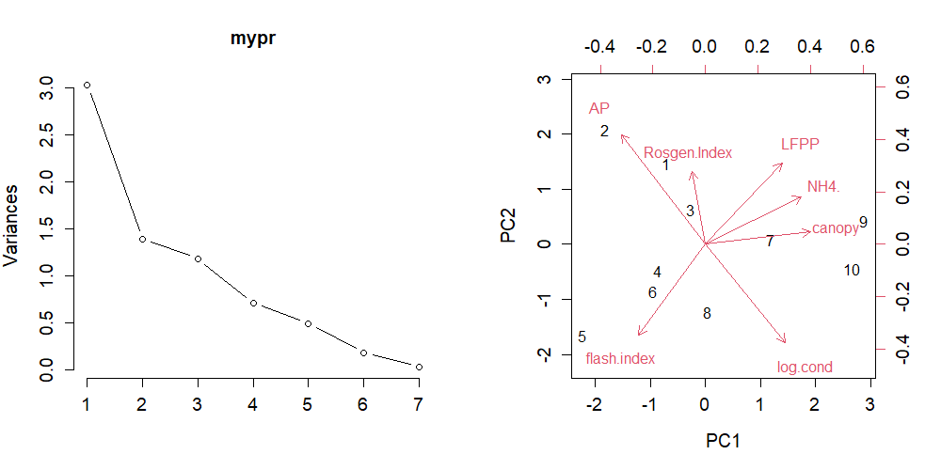

Use PCA to discern patterns in environmental variation among sites.
variable | PC1
canopy | 0.867128
NH4. | 0.792109
AP | -0.69812
log.cond | 0.662801
LFPP | 0.633236
flash.index | -0.55337
Rosgen.Index | -0.11131
variable | PC2
AP | 0.615274
log.cond | -0.54994
flash.index | -0.50805
LFPP | 0.455821
Rosgen.Index | 0.410933
NH4. | 0.265428
canopy | 0.068905
metric | Standard deviation | Proportion of Variance | Cumulative Proportion
PC1 | 1.739434199 | 0.43223 | 0.43223
PC2 | 1.179388223 | 0.19871 | 0.63094
PC3 | 1.085778668 | 0.16842 | 0.79936
PC4 | 0.839789846 | 0.10075 | 0.90011
PC5 | 0.699978246 | 0.07 | 0.9701
PC6 | 0.424007876 | 0.02568 | 0.99579
PC7 | 0.171748545 | 0.00421 | 1
Scree plot (left) and biplot (right) of Principle Component Analysis for 7 environmental predictors to be evaluated as predictors of fish and invertebrate assembly. Left, table contains cumulative variance explained by principle components. Above, Tables display correlations of environmental predictors with principle component axis 1 (top) and principle component 2 (middle) in descending order.

Slide 4
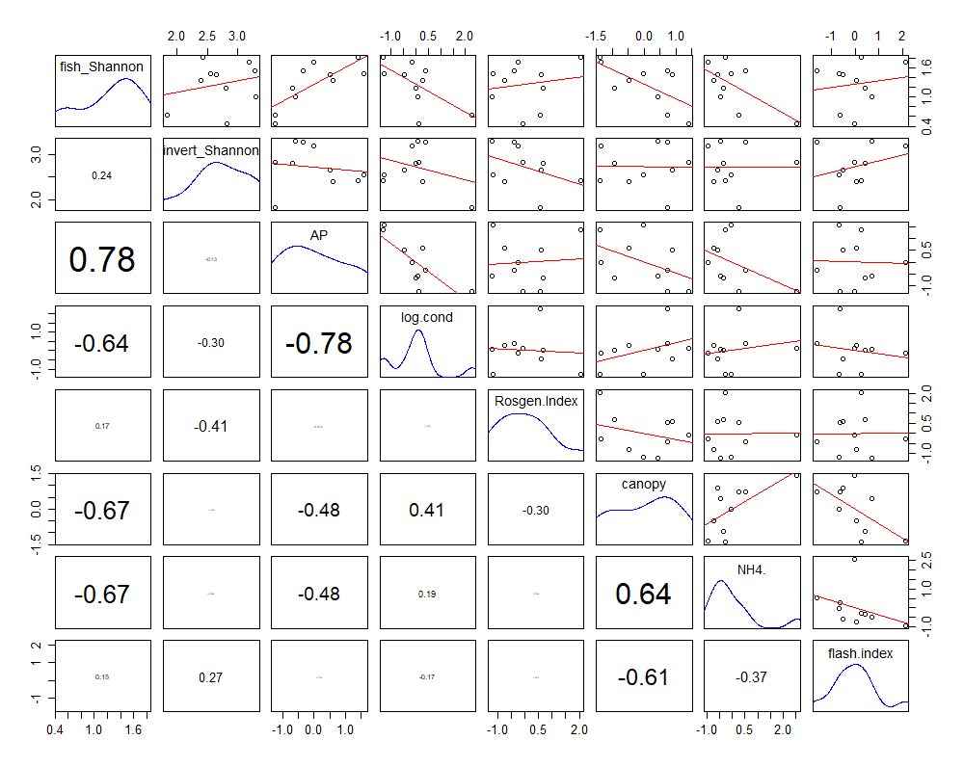
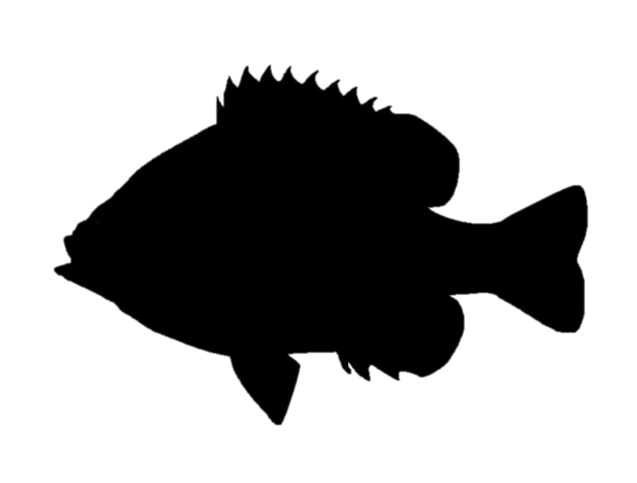
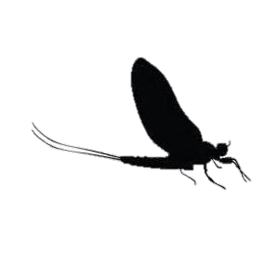
2. Use linear regressions to identify significant correlations with fish and invertebrate community diversity.
Shannon^{(f)}
Shannon^{(i)}
Pairs plots for fish and invertebrate Shannon index versus 7 scaled environmental predictors. Scatterplots and linear regressions are plotted in the top. Correlation coefficients are displayed in the bottom plots.
Precipitation
Conductivity
Rosgen Index
Canopy
This is a useful tool to identify strong correlations with our dependent variables (first 2 rows) and to see collinearities between independent variables (bottom 6 rows). AP covaries with conductivity, canopy, and NH4+ concentrations.
NH₄⁺
Flash Index

Slide 5
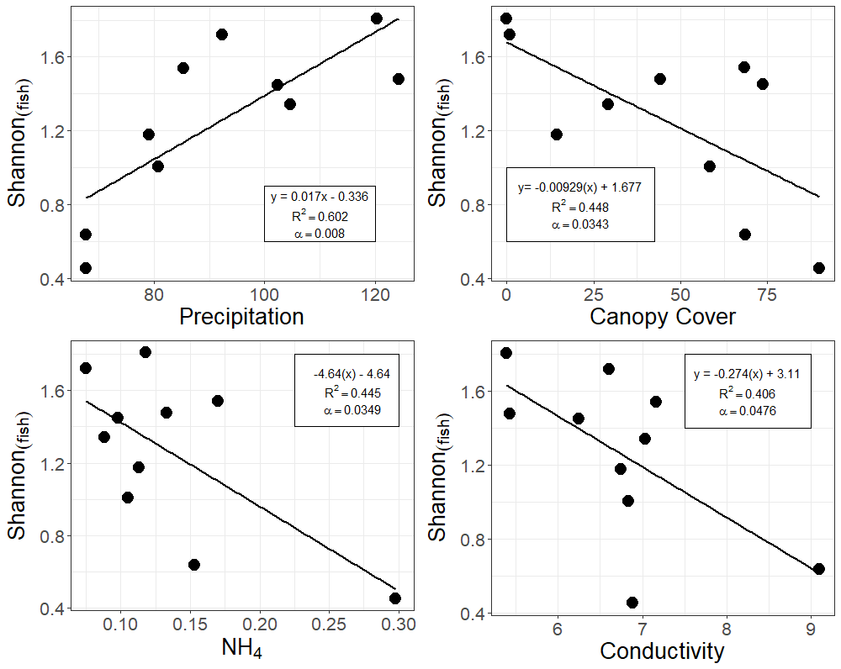
A
B
Fish diversity plotted against (A) annual precipitation (cm/yr), (B) Canopy cover (%), (C) NH4+ (mg/L), (D) log-transformed conductivity (µS/cm).
Shannon^{(f)}
Shannon^{(f)}
predictor | estimate | df | r2 | f.stat | p.value
AP | 0.017271 | 2 8 | 0.602017 | 12.10136 | 0.008336
log.cond | -0.27437 | 2 8 | 0.405813 | 5.463779 | 0.047603
Rosgen.Index | 0.021205 | 2 8 | 0.027242 | 0.224035 | 0.648629
canopy | -0.0093 | 2 8 | 0.447887 | 6.489777 | 0.034308
NH4. | -4.64708 | 2 8 | 0.445651 | 6.431349 | 0.034927
flash.index | 0.338843 | 2 8 | 0.023591 | 0.193286 | 0.67183
LFPP | -0.03083 | 2 8 | 0.338929 | 4.101581 | 0.077427
C
D
Shannon^{(f)}
Shannon^{(f)}
Linear regression statistics for a-priori selected environmental variables
NH₄⁺

Slide 6
3. Use multivariate regressions to create predictive models for fish and invertebrate community diversity.
model | (Int) | AP | cnp | fls.ind | LFPP | log.cnd | NH4. | Rsg.Ind | df | logLik | AICc | delta | weight
10 | 1.261 | 0.3127 |  |  | -0.2098 |  |  |  | 4 | 2.912 | 10.2 | 0 | 0.429
2 | 1.261 | 0.3462 |  |  |  |  |  |  | 3 | -0.985 | 12 | 1.79 | 0.175
4 | 1.261 | 0.2634 | -0.1715 |  |  |  |  |  | 4 | 0.69 | 14.6 | 4.44 | 0.046
34 | 1.261 | 0.2641 |  |  |  |  | -0.1711 |  | 4 | 0.688 | 14.6 | 4.45 | 0.046
49 | 1.261 |  |  |  |  | -0.2352 | -0.2521 |  | 4 | 0.649 | 14.7 | 4.52 | 0.045
3 | 1.261 |  | -0.2986 |  |  |  |  |  | 3 | -2.622 | 15.2 | 5.07 | 0.034
33 | 1.261 |  |  |  |  |  | -0.2979 |  | 3 | -2.642 | 15.3 | 5.11 | 0.033
17 | 1.261 |  |  |  |  | -0.2842 |  |  | 3 | -2.989 | 16 | 5.8 | 0.024
74 | 1.261 | 0.3014 |  |  | -0.2338 |  |  | 0.1025 | 5 | 4.501 | 16 | 5.82 | 0.023
1 | 1.261 |  |  |  |  |  |  |  | 2 | -5.592 | 16.9 | 6.72 | 0.015
Top ten Multivariate regression models predicting fish Shannon diversity.
model_name | var1 | estimate | var2 | estimate2 | var3 | estimate3 | adjusted_r2 | f.stat | df | p.value
Fm10 | AP | 0.312661569 | LFPP | -0.209790458 | na | na | 0.765305514 | 15.67386332 | 2 7 | 0.00259869
Fm4 | AP | 0.263436925 | canopy | -0.171468311 | na | na | 0.633976268 | 8.794284779 | 2 7 | 0.012310529
Fm34 | AP | 0.264055079 | NH4. | -0.171113979 | na | na | 0.633850528 | 8.79006278 | 2 7 | 0.012325337
Fm49 | log.cond | -0.235193285 | NH4. | -0.252107645 | na | na | 0.631013908 | 8.695581603 | 2 7 | 0.012662788
Fm74 | AP | 0.30138 | LFPP | -0.23384 | Rosgen.Index | 0.10252 | 0.8007 | 13.05 | 3 6 | 0.004866
Summary statistics for top five multivariate regressions predicant fish Shannon diversity
# Precipitation is a predictor in the top multivariate models and has the largest estimated slope compared to all other scaled environmental variables in the exhaustive multivariate regression.
# One multivariate regression utilizes 2 water quality parameters (conductivity and NH4).
# Positive predictors of fish diversity include AP and Rosgen Index
# Negative predictors of fish diversity include LFPP, canopy, NH4., log.cond

Slide 7
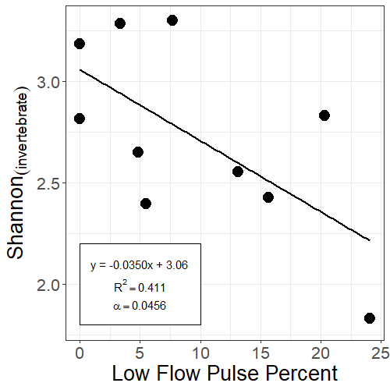
predictor | estimate | df | r2 | f.stat | p.value
AP | -0.00302 | 2 8 | 0.01736 | 0.141333 | 0.716733
log.cond | -0.13388 | 2 8 | 0.091107 | 0.801919 | 0.396664
Rosgen.Index | -0.05419 | 2 8 | 0.167748 | 1.612478 | 0.239833
canopy | -0.00022 | 2 8 | 0.000243 | 0.001946 | 0.965892
NH4. | -0.06524 | 2 8 | 8.28E-05 | 0.000662 | 0.980096
flash.index | 0.622914 | 2 8 | 0.075173 | 0.650264 | 0.443328
LFPP | -0.03498 | 2 8 | 0.411386 | 5.591259 | 0.045631
Shannon^{(i)}
Linear regression statistics for invertebrate Shannon index versus a-priori selected environmental variables
Invertebrate Shannon index plotted against Low Flow Pulse Percent.

Slide 8
model | (Int) | AP | cnp | fls.ind | LFP | log.cnd | NH4. | Rsg.Ind | df | logLik | AICc | delta | weight
9 | 3.057 |  |  |  | -0.03498 |  |  |  | 3 | -3.236 | 16.5 | 0 | 0.299
1 | 2.727 |  |  |  |  |  |  |  | 2 | -5.886 | 17.5 | 1.01 | 0.18
41 | 2.676 |  |  |  | -0.05369 |  | 4.133 |  | 4 | -0.967 | 17.9 | 1.46 | 0.144
65 | 3.596 |  |  |  |  |  |  | -0.05419 | 3 | -4.968 | 19.9 | 3.46 | 0.053
17 | 3.629 |  |  |  |  | -0.1339 |  |  | 3 | -5.409 | 20.8 | 4.34 | 0.034
5 | 2.159 |  |  | 0.6229 |  |  |  |  | 3 | -5.495 | 21 | 4.52 | 0.031
11 | 2.926 |  | 4.41E-03 |  | -0.04203 |  |  |  | 4 | -2.524 | 21 | 4.58 | 0.03
73 | 3.628 |  |  |  | -0.03162 |  |  | -0.03754 | 4 | -2.538 | 21.1 | 4.6 | 0.03
10 | 3.587 | -0.00551 |  |  | -0.03708 |  |  |  | 4 | -2.733 | 21.5 | 4.99 | 0.025
2 | 3.006 | -0.00302 |  |  |  |  |  |  | 3 | -5.799 | 21.6 | 5.12 | 0.023
Top ten Multivariate regression models predicting invertebrate Shannon diversity.
model_name | var1 | estimate | var2 | estimate2 | adjusted_r2 | f.stat | df | p.value
im1 | LFPP | -0.05369 | NH4. | 4.133124 | 0.519315 | 5.86164 | 2 7 | 0.031953
im2 | canopy | 0.004406 | LFPP | -0.04203 | 0.343686 | 3.35647 | 2 7 | 0.095036
im3 | AP | -0.00551 | LFPP | -0.03708 | 0.315609 | 3.075187 | 2 7 | 0.110042
Summary statistics for top five multivariate regressions predicant invertebrate Shannon diversity
# 7/10 top AICc models contained one or fewer environmental predictors. Previous univariate regressions indicate no statistically significant correlations
# 1/3 of the top AICc ranked multivariation regression models has a p value less than 0.05 and has an adjusted r^2 of 0.519 (-LFPP + NH4)
# Positive predictors of invertebrate diversity include NH4 and canopy
# Negative predictors of invertebrate diversity include LFPP and AP

Slide 9
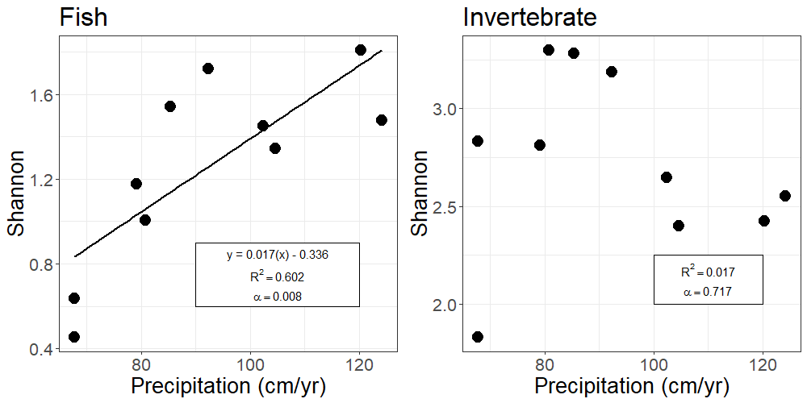
Hypothesis test: precipitation correlates with diversity?
A
B
Shannon^{(f)}
Shannon^{(i)}
Shannon diversity of fish (A) and invertebrate (B) communities for each site plotted against annual precipitation.
Fish Shannon index correlates positively with annual precipitation but invertebrate Shannon index does not significantly correlate.

Slide 10
4. Use PCoA ordinations to visualize patterns in community composition and identify coincidental environmental predictors
Replace NMDS with PCoA
Replace envfit with correspondence anlaysis
climate drives marine fish communities in slack paper
one plot of sites
one plot of vectors ccoa
table of results cca1, cca2, r2, df, chix2, fval

Slide 11
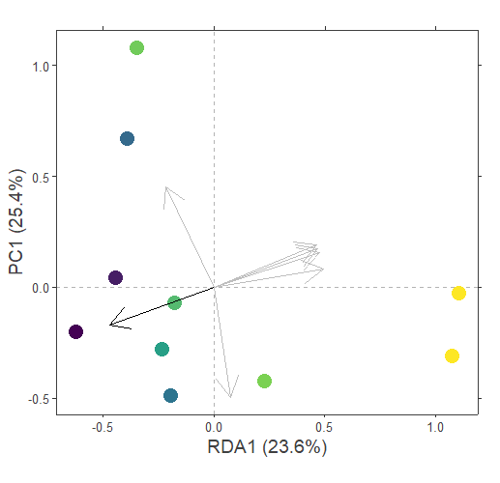
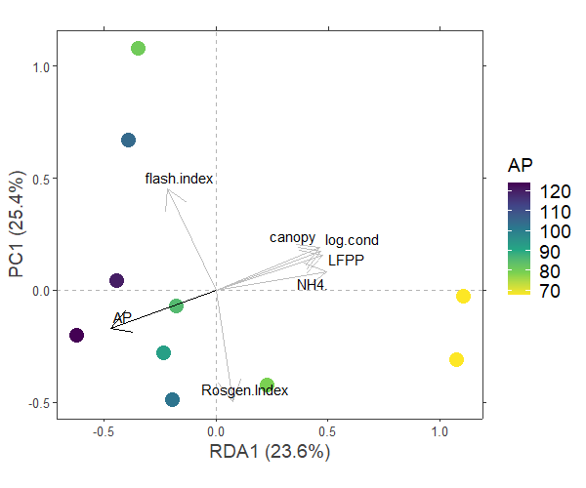
species | R² | p-value | axis1 | axis2
A.melas | 0.23023817 | 0.423 | -0.022387738 | 0.049458134
A.rostrata | 0.04895361 | 0.875 | -0.004901997 | 0.018920955
H.cyanoguttatus | 0.11674133 | 0.703 | 0.044499826 | 0.06724042
C.lutrensis | 0.8797549 | 0.007 | -0.217359354 | 0.626652466
C.venusta | 0.19174898 | 0.496 | -0.074923046 | -0.018880656
E.gracile | 0.01702391 | 1 | 0.023746088 | -0.009510118
F.notatus | 0.26996839 | 0.244 | -0.096394548 | -0.061708444
G.affinis | 0.61787634 | 0.041 | 0.187553123 | -0.339810377
L.auritis | 0.0954481 | 0.747 | 0.036414193 | 0.080138119
L.cyanellus | 0.27043676 | 0.32 | -0.072507811 | -0.166251083
L.gulosus | 0.17486578 | 0.476 | -0.099324212 | -0.010412806
L.humilis | 0.16582945 | 0.594 | -0.017865623 | -0.034986287
L.macrochirus | 0.75601603 | 0.018 | -0.240268678 | -0.061350821
L.marginatus | 0.16582945 | 0.594 | -0.025265807 | -0.049478082
L.megalotis | 0.72038963 | 0.013 | -0.407334824 | -0.020938185
P.latipinna | 0.8374159 | 0.016 | 0.414714616 | -0.089880974
P.vigilax | 0.02933178 | 0.914 | -0.136897484 | 0.033999261
T.maculatus | 0.23023817 | 0.423 | -0.012925567 | 0.028554667
1.0
0.5
Flash Index
Canopy
Conductivity
Low Flow Pulse %
PC1 (25.4%)
NH₄⁺
0
Precipitation
-0.5
Channel Morphology
-0.5
0.0
0.5
1.0
RDA1 (23.6%)
Redundancy Analysis : Hellinger-transformed fish community matrix
Constrained by Annual Precipitation
Sites are colored by annual precipitation (cm/year)
Arrows: The positions of species are interpreted as arrows generated by maximum correlation in ordination space (see table for correlation outputs). Only vectors with p-values <0.05 are plotted to improve figure clarity.

Slide 12
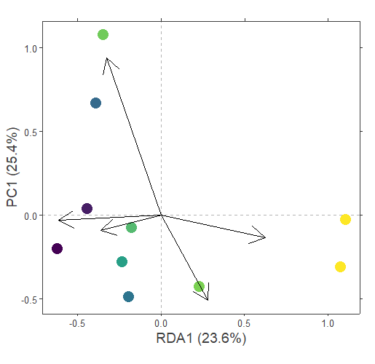
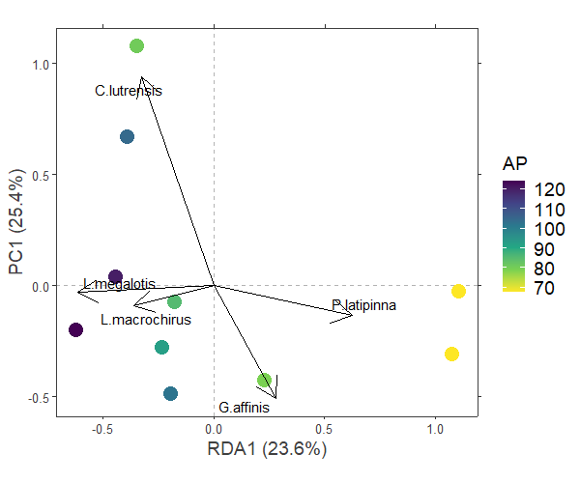
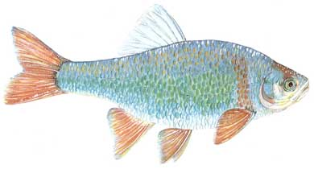
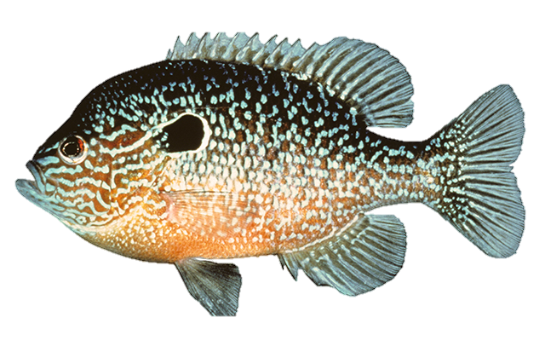
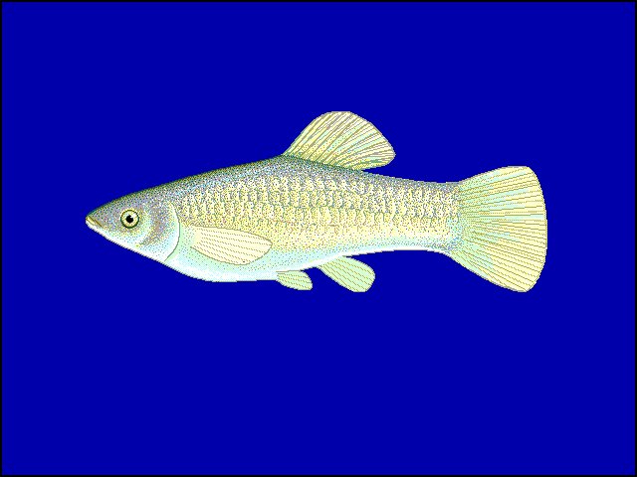
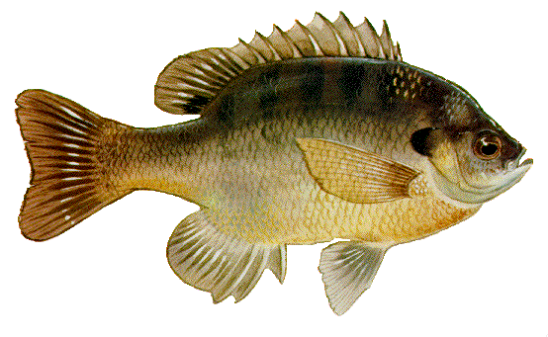
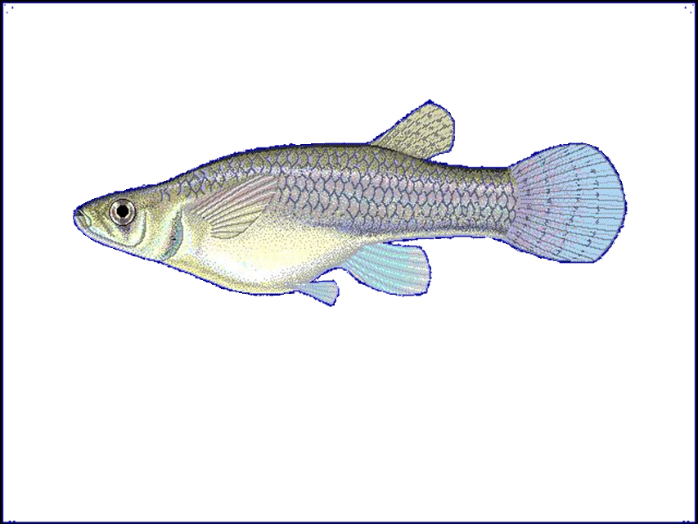
C. lutrensis
predictor | R² | p-value | axis1 | axis2
AP | 0.725622 | 0.013 | -0.940598 | -0.3395
log.cond | 0.538635 | 0.051 | 0.9384577 | 0.34539
Rosgen.Index | 0.240689 | 0.363 | 0.1488126 | -0.9889
canopy | 0.292377 | 0.302 | 0.9238926 | 0.38265
NH4. | 0.493665 | 0.104 | 0.985893 | 0.16738
flash.index | 0.03314 | 0.877 | -0.433603 | 0.9011
LFPP | 0.356723 | 0.214 | 0.948997 | 0.31529
1.0
0.5
L. megalotis
The projections of points onto vectors have maximum correlation with corresponding environmental variables, and the factors show the averages of factor levels.
PC1 (25.4%)
0
P. latipinna
L. macrochirus
G. affinis
-0.5
-0.5
0.0
0.5
1.0
RDA1 (23.6%)
Redundancy Analysis : Hellinger-transformed fish community matrix
Constrained by Annual Precipitation
Sites are colored by annual precipitation (cm/year)
Arrows: Environmental predictors are interpreted as arrows generated by maximum correlation in ordination space (see table for correlation outputs).

Slide 13
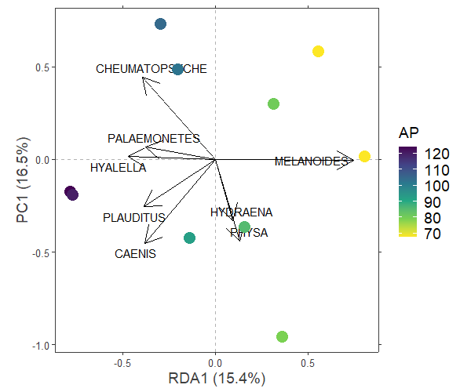
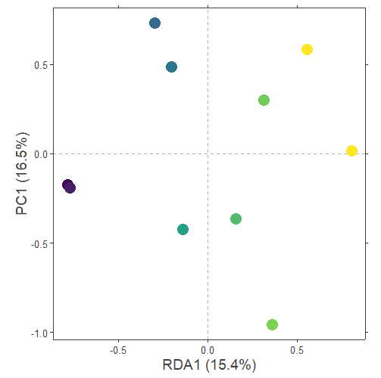
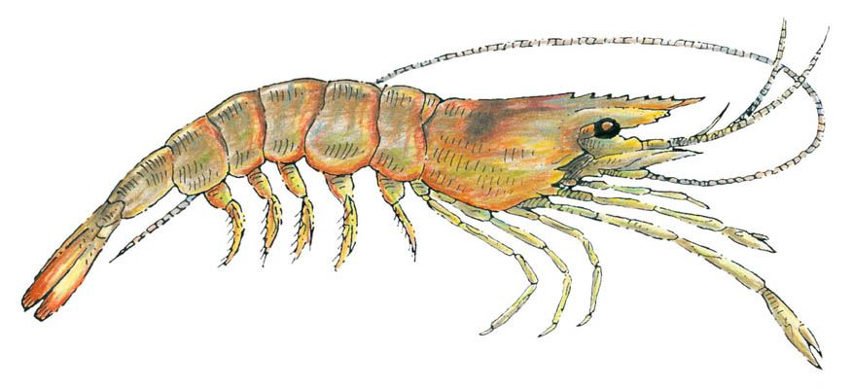
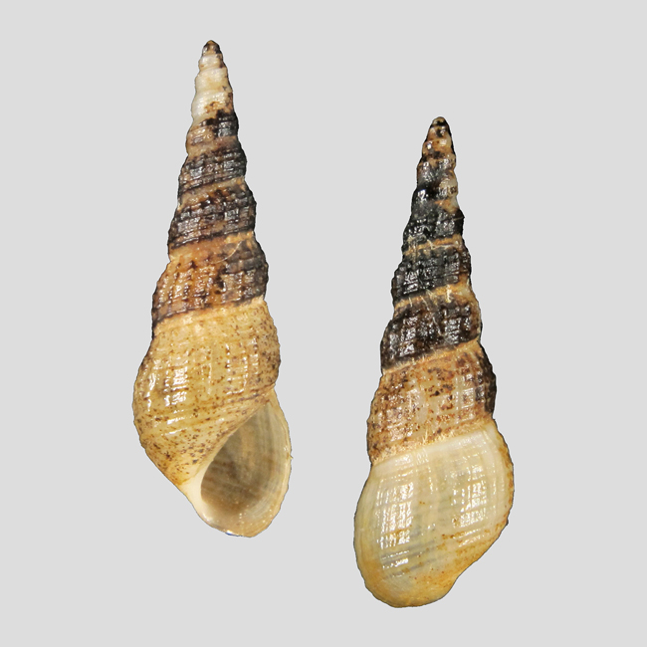
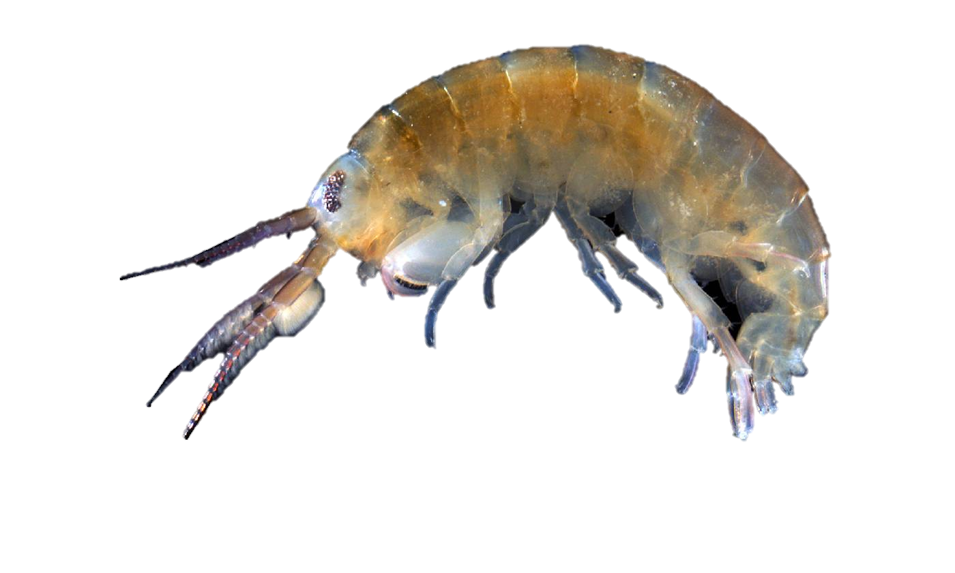
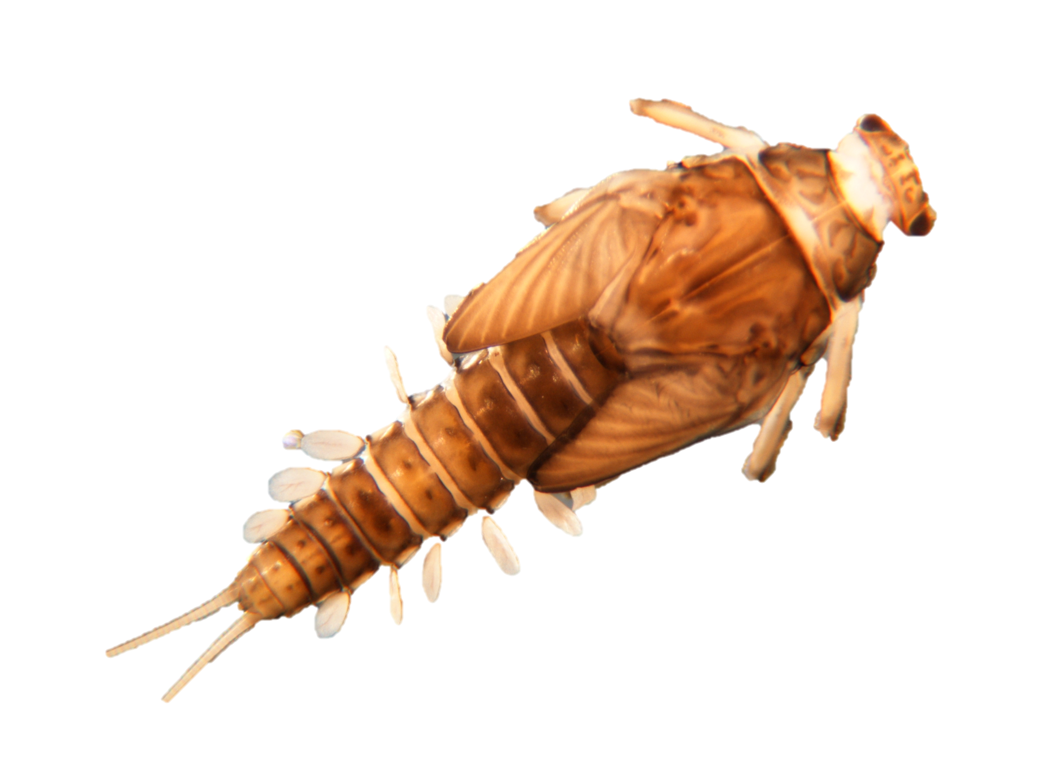
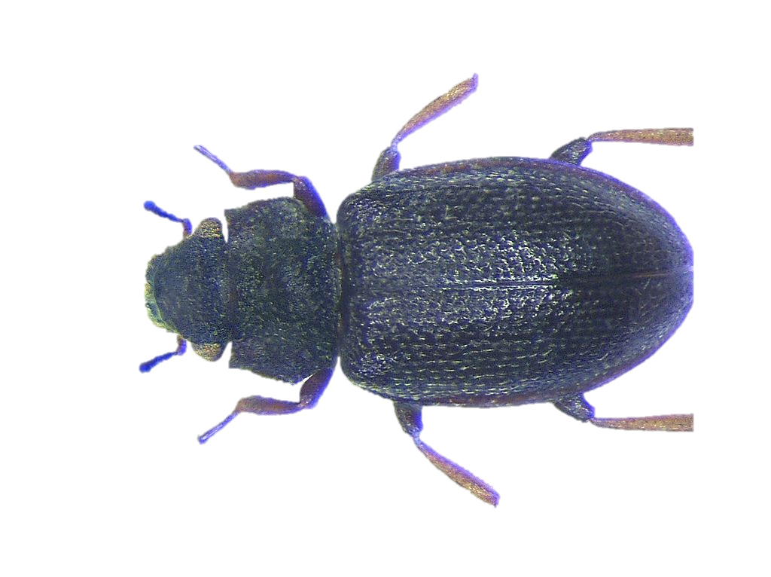
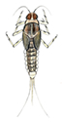
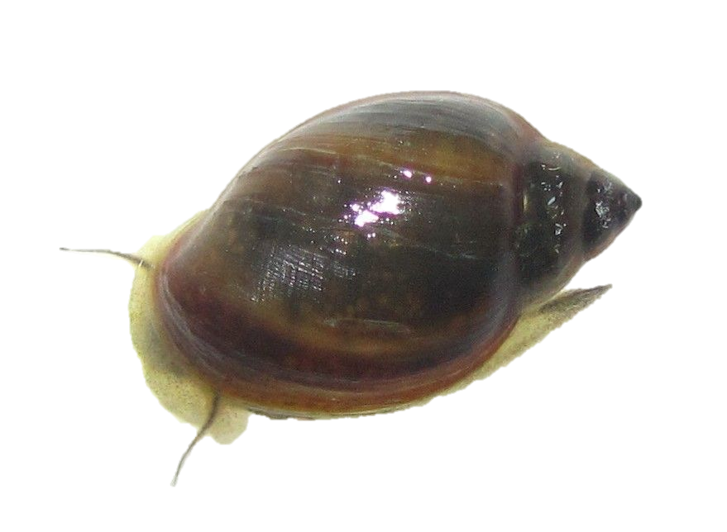
Species | R² | p-value | axis1 | axis2
Alisotrichia | 0.278124 | 0.497 | -0.0787 | -0.01637
Ameletus | 0.09205 | 0.697 | -0.05197 | -0.01859
Ametropus | 0 | 1 | 0 | 3.23E-17
Amnicola | 0.557658 | 0.072 | 0.067816 | 0.19706
Amphiagrion | 0.496395 | 0.102 | 0.033336 | -0.12992
Ancyronyx | 0.009591 | 0.968 | -0.00869 | 0.014862
Argia | 0.37329 | 0.205 | 0.147555 | -0.05412
Baetis | 0.013734 | 0.975 | 0.026729 | -0.00221
Baetodes | 0.278124 | 0.497 | -0.0787 | -0.01637
Belostoma | 0.270257 | 0.602 | -0.07326 | -0.01926
Berosus | 0 | 1 | 0 | 0
Biomphalaria | 0.517251 | 0.076 | 0.119822 | -0.08838
Bithynia | 0.174315 | 0.501 | -0.01336 | -0.1058
Brachycerus | 0.29809 | 0.312 | -0.07302 | -0.05883
Brechmorhoga | 0.392815 | 0.167 | 0.070816 | 0.064984
Caecidotea | 0.278631 | 0.391 | 0.073592 | 0.066135
Caenis | 0.642217 | 0.034 | -0.13507 | -0.16165
Calopteryx | 0.071467 | 1 | 0.014141 | -0.0277
Camelobaetidius | 0.081087 | 0.9 | 0.026557 | 0.025767
Campeloma | 0.197974 | 0.544 | 0.048071 | 0.090109
Centroptilum | 0.470995 | 0.109 | 0.033093 | -0.09035
Cercobrachys | 0.09205 | 0.697 | -0.05197 | -0.01859
Cheumatopsyche | 0.740952 | 0.009 | -0.13976 | 0.158003
Chromagrion | 0.071467 | 1 | 0.014141 | -0.0277
Cloeon | 0 | 1 | 0 | 0
Corbicula | 0.164334 | 0.551 | -0.09754 | 0.057242
Cyphon | 0.251092 | 0.34 | -0.04735 | 0.103009
Dubiraphia | 0.30962 | 0.265 | -0.02857 | 0.121229
Elodes | 0.125092 | 0.694 | -0.02283 | 0.042559
Erpetogomphus | 0.392815 | 0.167 | 0.100149 | 0.091902
Erythemis | 0.470995 | 0.109 | 0.033093 | -0.09035
Fallceon | 0.624436 | 0.063 | -0.17455 | -0.03264
Farrodes | 0.078979 | 0.737 | 0.033091 | -0.03746
Ferrissia | 0.041635 | 0.869 | 0.010086 | 0.033082
Fossaria | 0.305494 | 0.351 | 0.10087 | -0.02573
Gammarus | 0.392815 | 0.167 | 0.070816 | 0.064984
Glaenocorisa | 0 | 1 | 0 | 0
Gyraulus | 0 | 1 | 0 | 0
Gyretes | 0.071467 | 1 | 0.014141 | -0.0277
Hebrus | 0.278631 | 0.391 | 0.052037 | 0.046764
Helicina | 0.081087 | 0.9 | 0.018779 | 0.01822
Helisoma | 0.102486 | 0.7 | -0.03842 | 0.048578
Hetaerina | 0 | 1 | 0 | 0
Heterelmis | 0.071467 | 1 | 0.014141 | -0.0277
Hyalella | 0.780031 | 0.005 | -0.16756 | 0.005313
Hydraena | 0.552657 | 0.065 | 0.033265 | -0.11833
Hydrobius | 0.470995 | 0.109 | 0.033093 | -0.09035
Hydropsyche | 0.081087 | 0.9 | 0.018779 | 0.01822
Isonychiidae | 0.081087 | 0.9 | 0.026557 | 0.025767
Leptoceridae | 0.055541 | 0.793 | 0.046556 | -0.0134
Leptohyphes | 0.302371 | 0.265 | -0.05895 | -0.07494
Leptonema | 0.278631 | 0.391 | 0.052037 | 0.046764
Limnocoris | 0.071467 | 1 | 0.014141 | -0.0277
Limnoporus | 0.087723 | 0.8 | 0.000297 | -0.04846
Linisa | 0.071467 | 1 | 0.014141 | -0.0277
Lipogomphus | 0.081087 | 0.9 | 0.018779 | 0.01822
Macrelmis | 0.081087 | 0.9 | 0.018779 | 0.01822
Macronychus | 0.125092 | 0.694 | -0.02283 | 0.042559
Melanoides | 0.691493 | 0.017 | 0.265552 | -0.00212
Menetus | 0 | 1 | 0 | 0
Mesovelia | 0.470995 | 0.109 | 0.033093 | -0.09035
Metrichia | 0.087723 | 0.8 | 0.000171 | -0.02798
Microvelia | 0.087723 | 0.8 | 0.000171 | -0.02798
Morphocorixa | 0 | 1 | 0 | 0
Neoelmis | 0 | 1 | 0 | 0
Neoneura | 0.278631 | 0.391 | 0.052037 | 0.046764
Neoplea | 0.012323 | 0.925 | 0.01895 | -0.00976
Orconectes | 0.278631 | 0.391 | 0.052037 | 0.046764
Palaemonetes | 0.574876 | 0.042 | -0.13503 | 0.023684
Pelocoris | 0.071467 | 1 | 0.014141 | -0.0277
Peltodytes | 0.510337 | 0.089 | -0.01776 | -0.17184
Philopotamidae | 0.081087 | 0.9 | 0.026557 | 0.025767
Physa | 0.638867 | 0.03 | 0.047477 | -0.15761
Physella | 0.158681 | 0.555 | -0.05431 | -0.02902
Pisidium | 0.279282 | 0.303 | -0.03866 | 0.088146
Planorbula | 0 | 1 | 0 | 0
Plauditus | 0.661025 | 0.045 | -0.13765 | -0.09131
Potamyia | 0 | 1 | 0 | 0
Procloeon | 0.071467 | 1 | 0.014141 | -0.0277
Pseudocloeon | 0.087723 | 0.8 | 0.000171 | -0.02798
Pseudosuccinea | 0.016499 | 0.957 | -0.0148 | 0.028147
Ranatra | 0.470995 | 0.109 | 0.033093 | -0.09035
Rhagovelia | 0.392815 | 0.167 | 0.100149 | 0.091902
Rhematobates | 0.081087 | 0.9 | 0.018779 | 0.01822
Scirtes | 0.071467 | 1 | 0.014141 | -0.0277
Siphlonurus | 0.278631 | 0.391 | 0.052037 | 0.046764
Smicridea | 0 | 1 | 0 | 0
Sphaeridiinae | 0 | 1 | 0 | 0
Stactobiella | 0.279282 | 0.303 | -0.03866 | 0.088146
Stenelmis | 0.22286 | 0.413 | -0.02798 | 0.125115
Stenonema | 0.125092 | 0.694 | -0.03229 | 0.060187
Strobilops | 0.087723 | 0.8 | 0.000171 | -0.02798
Synaptonecta | 0 | 1 | 0 | 0
Trepobates | 0.15686 | 0.595 | 0.014383 | -0.06727
Valvata | 0.470995 | 0.109 | 0.033093 | -0.09035
Cheumatopsyche
0.5
Palaemonetes
Melanoides
0.0
Hyalella
0
PC1 (16.5%)
Plauditus
-0.5
Hydraena
Caenis
Physa
-1.0
-0.5
0.0
0.5
RDA1 (15.4%)
Redundancy Analysis : Hellinger-transformed invertebrate community matrix
Constrained by Annual Precipitation
Sites are colored by annual precipitation (cm/year)
Arrows: The positions of species are interpreted as arrows generated by maximum correlation in ordination space (see table for correlation outputs). Only vectors with p-values <0.05 are plotted to improve figure clarity.

Slide 14
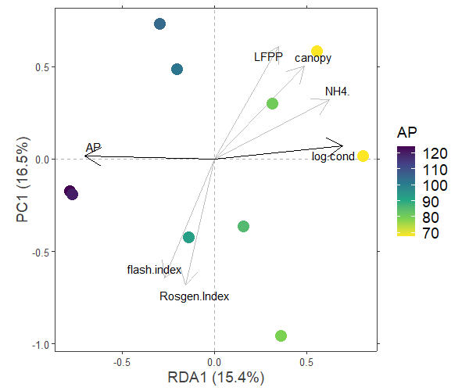
Low Flow Pulse %
Predictor | axis1 | axis2 | R² | p-value
AP | -0.9997573 | 0.02203034 | 0.97630889 | 0.001
log.cond | 0.9947189 | 0.10263696 | 0.71112442 | 0.01
Rosgen.Index | -0.2220796 | -0.97502853 | 0.07441911 | 0.766
canopy | 0.6974804 | 0.7166039 | 0.54993554 | 0.069
NH4. | 0.8878623 | 0.46010922 | 0.24973926 | 0.362
flash.index | -0.3886091 | -0.92140273 | 0.02211306 | 0.932
LFPP | 0.4940106 | 0.86945586 | 0.17072192 | 0.512
0.5
Canopy
NH₄⁺
Precipitation
Conductivity
0
PC1 (16.5%)
-0.5
Flash Index
Channel Morphology
-1.0
-0.5
0.0
0.5
RDA1 (15.4%)
Redundancy Analysis : Hellinger-transformed invertebrate community matrix
Constrained by Annual Precipitation
Sites are colored by annual precipitation (cm/year)
Arrows: Environmental predictors are interpreted as arrows generated by maximum correlation in ordination space (see table for correlation outputs). Black arrows indicate statistically significant correlations.

Slide 15
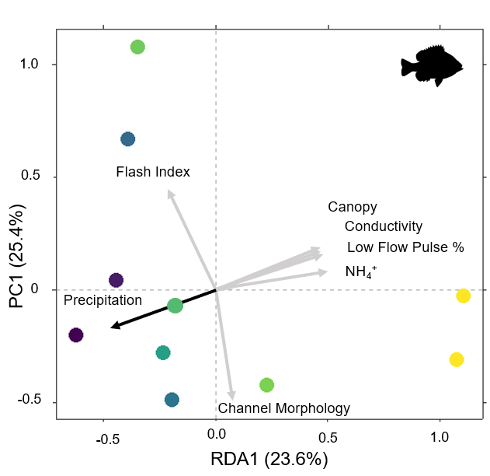
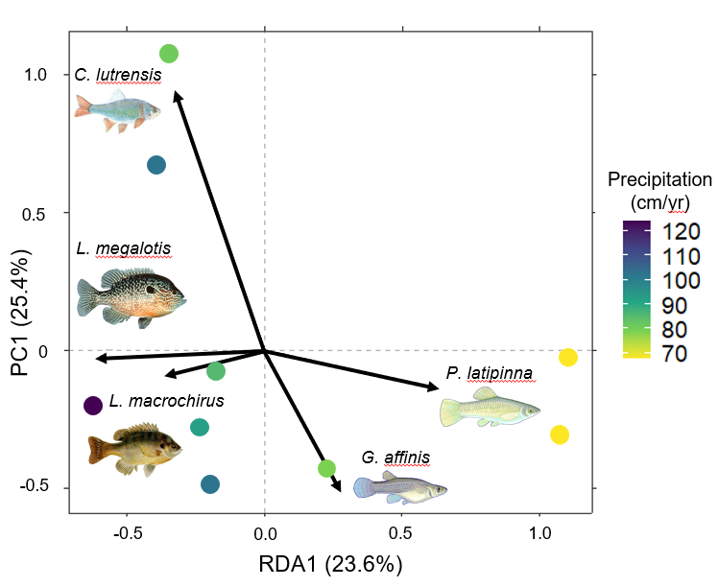
A
B
P-value
< 0.05
> 0.05
Fish community ordinations using Hellinger transformation and redundancy analysis. Dots represent sites with color determined by annual precipitation. Arrows represent fitted vectors for (A) environmental predictors and (C) species which can be visually interpreted based on their direction. Black arrows indicate statistically significant (p-value < 0.05) correlations. Only significant species vectors were plotted to improve figure clarity.

Slide 16
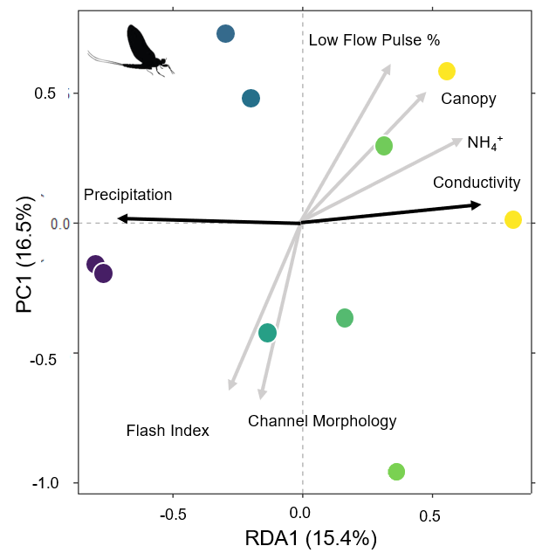
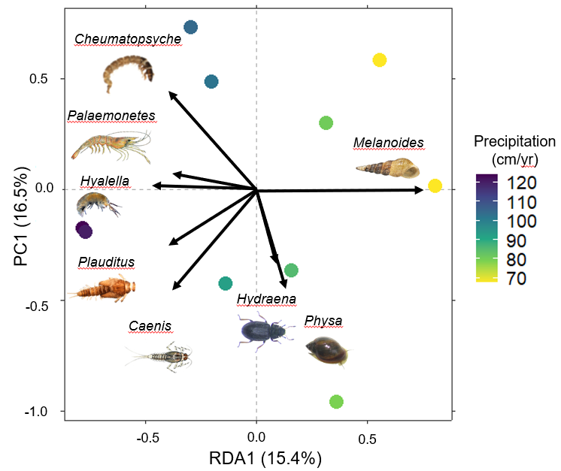
(A)
(B)
Macroinvertebrate community ordinations using Hellinger transformation and redundancy analysis. Dots represent sites with color determined by annual precipitation. Arrows represent fitted vectors for (A) environmental predictors and (B) species which can be visually interpreted based on their direction. Black arrows indicate statistically significant (p-value < 0.05) correlations. Only significant species vectors were plotted to improve figure clarity.

Slide 17
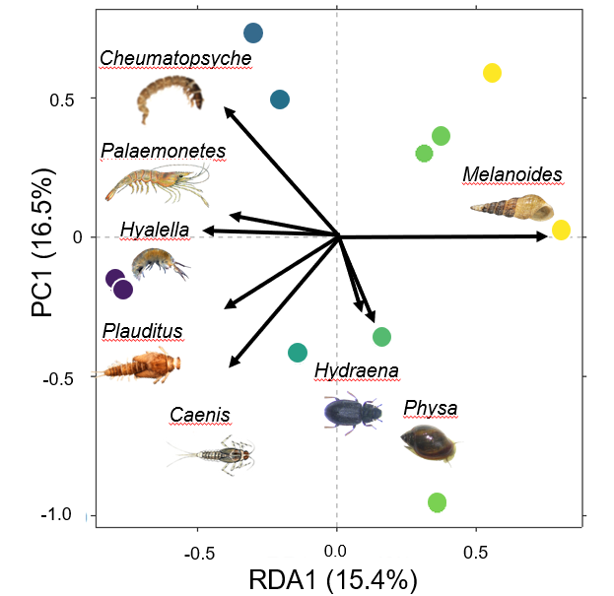
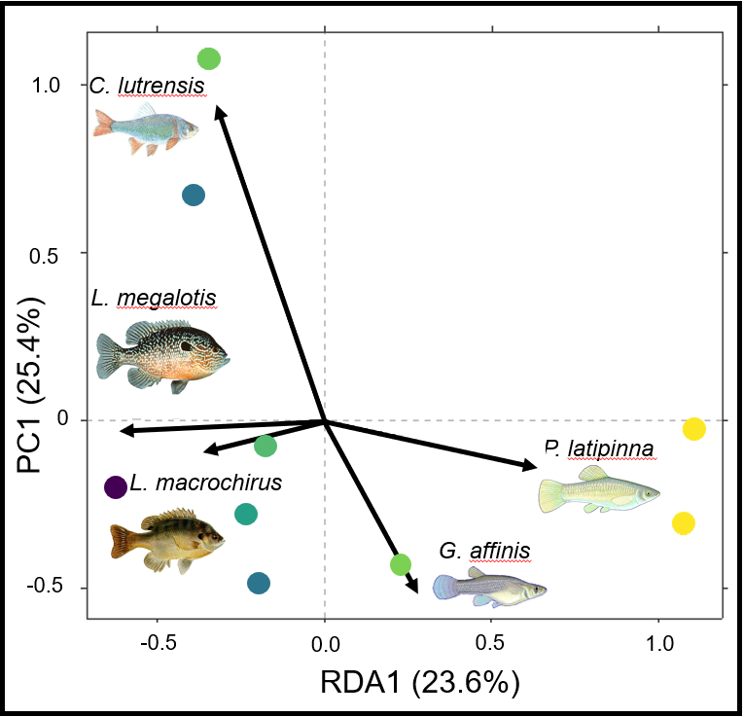
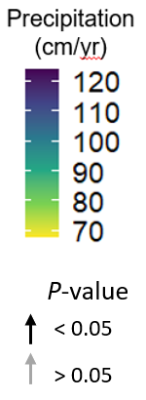
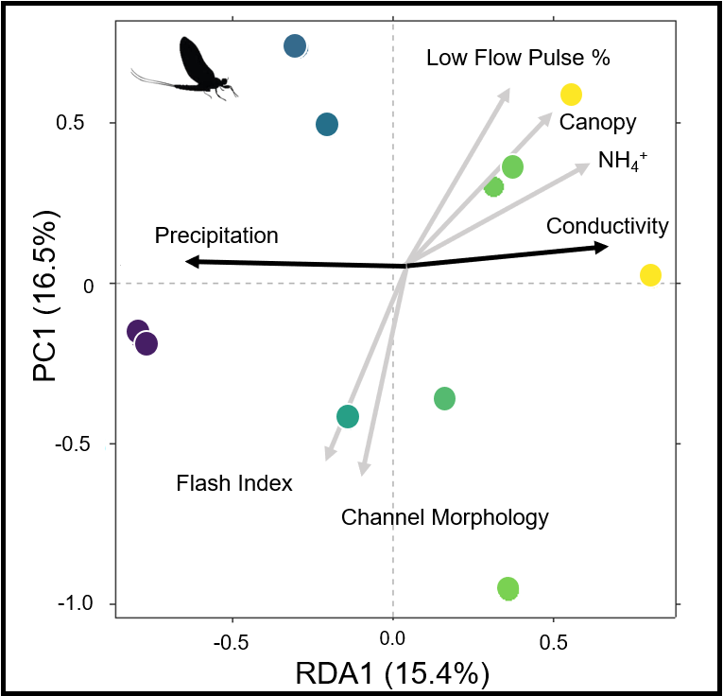
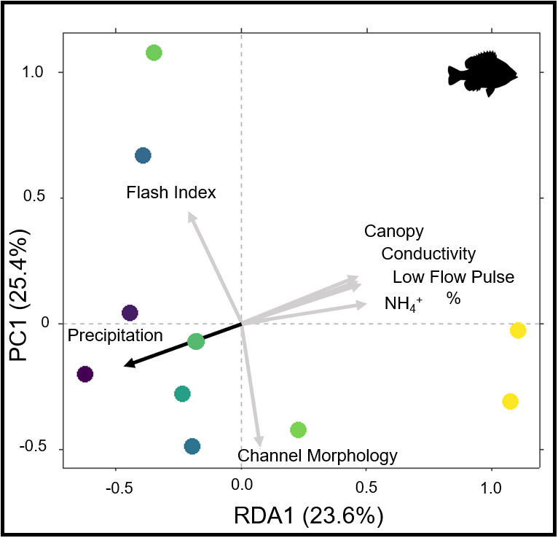
A
B
Ordinations of invertebrate (left: A & C) and fish (right: B & D) communities using Hellinger transformation and redundancy analysis. Dots represent sites with color determined by annual precipitation. Arrows represent fitted vectors for species (Top: A & B) and environmental predictors (bottom: C & D) which can be visually interpreted based on their direction. Black arrows indicate statistically significant (p-value < 0.05) correlations. Only significant species vectors were plotted to improve figure clarity.
C
D

Slide 18
Final Figures
Table1: Significant Environmental linear relationships (v1, v2, R2, p, +/-, fstat, df)
Figure1: Environmental PCA
Figure2: Fish Diversity and Ordinations
Table2: Fish multivariate regression outputs (v1, v2, v3, +/-, coef, R2, pm fstat, df)
Figure3: Invertebrate Diversity and ordination
Table3: Invertebrate multivariate regression tables
Appendix tables:
“T1_E_LM” ~ All env regression outputs
“F1_E_PCA” ~ All Environmental PCA outputs
“F2_F_LM” ~ fish regression outputs
“F2_F_RDA” ~ ordination outputs (envfits)
“F3_I_LM” ~ Inv regression outputs
“F3_I_LM” ~ ordination outputs
“S1_E_data” ~ supplemental environmental data

Slide 19
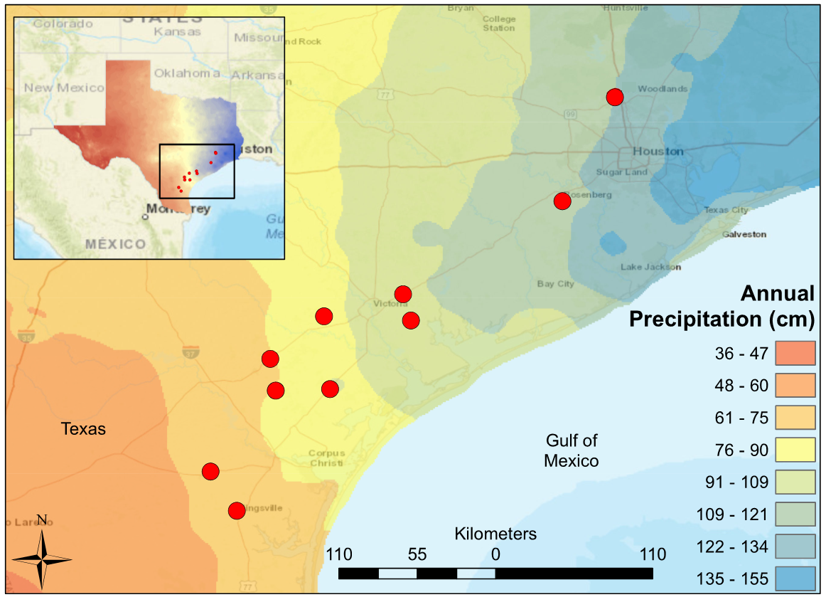
Notes:
Figure 1: Map of South Central Texas, where 10 USGS gaged Streams were sampled in the Spring of 2017. An annual precipitation overlay indicate that the sample sites span a gradient from 61 cm/yr in the Southwest to 134 cm/yr in the Northeast.

Slide 20
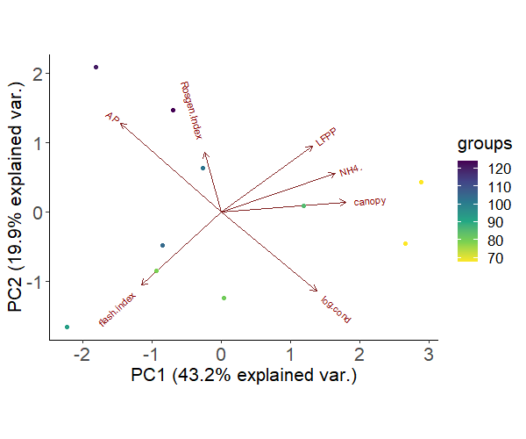
Precipitation
Low Flow
Pulse %
Rosgen Index
Precipitation
(cm/yr)
NH₄⁺
PC1 (19.9%)
Canopy
Flash Index
Conductivity
PC1 (43.2%)
Notes:
Figure 1: Principal Component Analysis of environmental predictors at 10 sites spanning a precipitation gradient along the Texas Coastal Prairie. Circles representing sample sites are colored based on their annual precipitation. Axes labels include the percentage of variance explained by PC1 (horizontal axis) and PC2 (vertical axis).

Slide 21
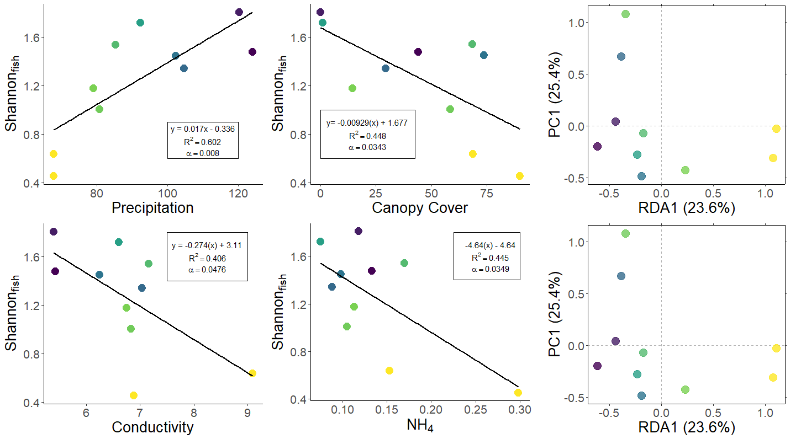
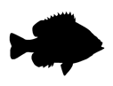
C. lutrensis
L. megalotis
P. latipinna
L. macrochirus
G. affinis
Flash Index
Conductivity
Canopy
Low Flow Pulse %
NH₄⁺
Precipitation
Rosgen Index
NH₄⁺
Notes:
Figure 2: Fish diversity plotted against (A) annual precipitation (cm/yr), (B) NH₄⁺ (mg/L), (C) canopy cover (%), (D) log-transformed conductivity (µS/cm). (E & F) Fish community ordinations using Hellinger transformation and redundancy analysis. Axes labels display the proportion of the variance explained as a percentage. Colored circles represent sites with color determined by annual precipitation. Arrows depict fitted vectors for (E) species and (F) environmental predictors which can be visually interpreted based on their direction. Black arrows indicate statistically significant (p-value < 0.05) correlations. Only significant species vectors were plotted to improve figure clarity.

Slide 22
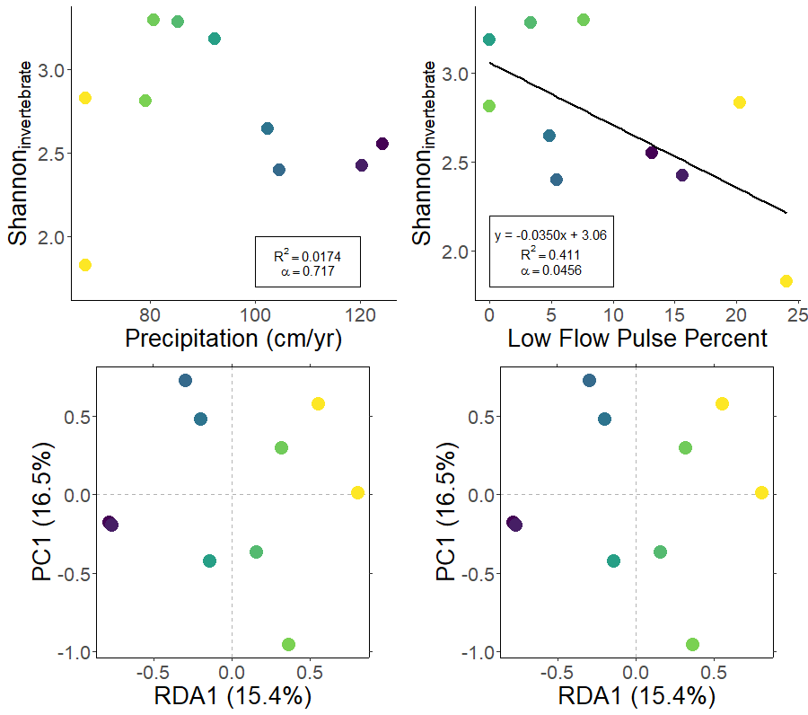
A
B
C
D
Low Flow Pulse %
Cheumatopsyche
Canopy
Palaemonetes
NH₄⁺
Precipitation
Hyalella
Conductivity
Melanoides
Plauditus
Hydraena
Caenis
Physa
Flash Index
Rosgen Index
Notes:
Figure 3: Macroinvertebrate Shannon diversity plotted against (A) annual precipitation (cm/yr) and (B) Low Flow Pulse Percent. (C & D) Fish community ordinations using Hellinger transformation and redundancy analysis. Axes labels contain proportion of the variance explained as a percentage. Dots represent sites with color determined by annual precipitation. Arrows represent fitted vectors for (E) environmental predictors and (F) species which can be visually interpreted based on their direction. Black arrows indicate statistically significant (p-value < 0.05) correlations. Only significant species vectors were plotted to improve figure clarity.

Slide 23
Site Name | USGS Station ID | Precipitation | Conductivity | Rosgen Index | Canopy | NH₄⁺ | Flash Index | Low Flow Pulse %
Bear Branch | 8068390 | 124.19 | 5.426 | 12.011 | 44.144 | 0.133 | 0.777 | 13.146
Big Creek | 8115000 | 120.31 | 5.390 | 23.150 | 0.000 | 0.118 | 0.961 | 15.631
Garcitas | 8164600 | 102.41 | 6.249 | 18.161 | 73.649 | 0.098 | 0.806 | 4.867
Placedo | 8164800 | 104.65 | 7.035 | 13.380 | 29.279 | 0.088 | 0.921 | 5.482
Perdido | 8177300 | 92.37 | 6.602 | 15.152 | 0.901 | 0.075 | 1.339 | 0.000
Medio | 8189300 | 79.13 | 6.748 | 18.405 | 14.414 | 0.113 | 0.993 | 0.000
Mission | 8189500 | 85.36 | 7.163 | 14.701 | 68.468 | 0.170 | 0.580 | 3.357
Aransas | 8189700 | 80.77 | 6.835 | 11.781 | 58.559 | 0.105 | 1.053 | 7.664
San Fernando | 8211900 | 67.75 | 6.887 | 15.762 | 89.865 | 0.298 | 0.907 | 20.306
Tranquitas | 8212300 | 67.75 | 9.096 | 17.988 | 68.769 | 0.153 | 0.781 | 24.060

Slide 24
Notes:
Table 1: Summary statistics for linear autocorrelations among environmental predictors. * denotes a statistically significant correlation (p-value < 0.05).

Slide 25
Response | Input | Sign | Slope | R² | F-stat | df | p-value
Shannon_{Fish} | Canopy | - | 0.009 | 0.448 | 6.490 | 1 | 0.034 *
Shannon_{Fish} | Conductivity | - | 0.274 | 0.406 | 5.464 | 1 | 0.048 *
Shannon_{Fish} | Flash Index | + | 0.339 | 0.024 | 0.193 | 1 | 0.672
Shannon_{Fish} | Low Flow Pulse % | - | 0.031 | 0.339 | 4.102 | 1 | 0.077
Shannon_{Fish} | NH₄⁺ | - | 4.647 | 0.446 | 6.431 | 1 | 0.035 *
Shannon_{Fish} | Precipitation | + | 0.017 | 0.602 | 12.101 | 1 | 0.008 *
Shannon_{Fish} | Rosgen Index | + | 0.021 | 0.027 | 0.224 | 1 | 0.649
Notes:
Table 2: Summary statistics for linear regressions of fish Shannon Index values versus environmental predictors. * denotes a statistically significant correlation (p-value < 0.05).

Slide 26
Formula | Degrees of Freedom | Log-Likelihood | AIC_{c} | Δ AIC_{c} | Weight
+ 0.313*Precipitation - 0.210*Low Flow Pulse % | 4 | 2.912 | 10.2 | 0 | 0.429
+ 0.346*Precipitation | 3 | -0.985 | 12 | 1.79 | 0.175
+ 0.263*Precipitation - 0.172*Canopy | 4 | 0.69 | 14.6 | 4.44 | 0.046
+ 0.264*Precipitation -0.171*NH4+ | 4 | 0.688 | 14.6 | 4.45 | 0.046
-0.235*Conductivity - 0.252*NH4+ | 4 | 0.649 | 14.7 | 4.52 | 0.045
-0.299*Canopy | 3 | -2.622 | 15.2 | 5.07 | 0.034
-0.298*NH4+ | 3 | -2.642 | 15.3 | 5.11 | 0.033
- 0.284*Conductivity | 3 | -2.989 | 16 | 5.8 | 0.024
+ 0.301*Precipitation - 0.234*Low Flow Pulse % + 0.103*Rosgen Index | 5 | 4.501 | 16 | 5.82 | 0.023
random effects | 2 | -5.592 | 16.9 | 6.72 | 0.015
- 0.26*Low Flow Pulse % | 3 | -3.523 | 17 | 6.87 | 0.014
+ 0.348*Precipitation + 0.077*Flash Index | 4 | -0.594 | 17.2 | 7.01 | 0.013
+ 0.273*Precipitation - 0.092*Canopy - 0.177*Low Flow Pulse % | 5 | 3.732 | 17.5 | 7.36 | 0.011
+ 0.343*Precipitation + 0.049*Rosgen Index | 4 | -0.834 | 17.7 | 7.49 | 0.010
- 0.219*Canopy - 0.195*Conductivity | 4 | -0.936 | 17.9 | 7.7 | 0.009
+ 0.321*Precipitation - 0.033*Conductivity | 4 | -0.959 | 17.9 | 7.74 | 0.009
- 0.195*Low Flow Pulse % - 0.229*Conductivity | 4 | -1.248 | 18.5 | 8.32 | 0.007
+ 0.357*Precipitation - 0.219*Low Flow Pulse % + 0.058*Conductivity | 5 | 3.082 | 18.8 | 8.66 | 0.006
+ 0.294*Precipitation - 0.185*Low Flow Pulse % - 0.047*NH4+ | 5 | 3.061 | 18.9 | 8.7 | 0.006
- 0.230*Canopy - 0.163*Low Flow Pulse % | 4 | -1.51 | 19 | 8.84 | 0.005
+ 0.314*Precipitation + 0.013*Flash Index - 0.206*Low Flow Pulse % | 5 | 2.932 | 19.1 | 8.96 | 0.005
- 0.411*Canopy - 0.183*Flash Index | 4 | -1.568 | 19.1 | 8.96 | 0.005
- 0.183*Canopy - 0.180*NH4+ | 4 | -1.669 | 19.3 | 9.16 | 0.004
Notes:
Table 3. Predictor variables and coefficients (formula), degrees of freedom (df) , log-likelihood, Akaike’s Information Criterion with the small-sample bias adjustment (AIC_{c} ), difference from the best-ranked model’s AIC_{c} (Δ AIC_{c} ), and Akaike weights (w) for set of candidate models predicting fish Shannon diversity.

Slide 27
Vector Input | axis1 | axis2 | R² | p-value
Canopy | 0.924 | 0.383 | 0.292 | 0.302
Conductivity | 0.938 | 0.345 | 0.539 | 0.051
Flash Index | -0.434 | 0.901 | 0.033 | 0.877
Low Flow Pulse % | 0.949 | 0.315 | 0.357 | 0.214
NH₄⁺ | 0.986 | 0.167 | 0.494 | 0.104
Precipitation | -0.941 | -0.340 | 0.726 | 0.013 *
Rosgen Index | 0.149 | -0.989 | 0.241 | 0.363
C.lutrensis | -0.217 | 0.627 | 0.880 | 0.007 *
L.megalotis | -0.407 | -0.021 | 0.720 | 0.013 *
P.latipinna | 0.415 | -0.090 | 0.837 | 0.016 *
L.macrochirus | -0.240 | -0.061 | 0.756 | 0.018 *
G.affinis | 0.188 | -0.340 | 0.618 | 0.041 *
Notes:
Table 4: Radial coordinates and summary statistics for fitted vectors of species and environmental predictors within the fish RDA ordination. * denotes a statistically significant correlation (p-value < 0.05)

Slide 28
Response | Input | Sign | estimate | df | R² | F-stat | p-value
Shannon_{Invert} | Precipitation | - | 0.003 | 2 | 0.017 | 0.141 | 0.717
Shannon_{Invert} | Conductivity | - | 0.134 | 2 | 0.091 | 0.802 | 0.397
Shannon_{Invert} | Rosgen Index | - | 0.054 | 2 | 0.168 | 1.612 | 0.240
Shannon_{Invert} | Canopy | - | 0.000 | 2 | 0.000 | 0.002 | 0.966
Shannon_{Invert} | NH₄⁺ | - | 0.065 | 2 | 0.000 | 0.001 | 0.980
Shannon_{Invert} | Flash Index | + | 0.623 | 2 | 0.075 | 0.650 | 0.443
Shannon_{Invert} | Low Flow Pulse % | - | 0.035 | 2 | 0.411 | 5.591 | 0.046
Notes:
Table 5: Summary statistics for linear regressions of inverebrate Shannon Index values versus environmental predictors. * denotes a statistically significant correlation (p-value < 0.05).

Slide 29
Candidate Model Formula | df | Log-Likelihood | AIC_{c} | Δ AIC_{c} | Weight
-0.035*Low Flow Pulse % | 3 | -3.236 | 16.5 | 0 | 0.299
Random Effects | 2 | -5.886 | 17.5 | 1.01 | 0.18
-0.054*Low Flow Pulse % + 4.133*NH₄⁺ | 4 | -0.967 | 17.9 | 1.46 | 0.144
-0.054*Rosgen Index | 3 | -4.968 | 19.9 | 3.46 | 0.053
-0.134*Conductivity | 3 | -5.409 | 20.8 | 4.34 | 0.034
+ 0.623*Flash Index | 3 | -5.495 | 21 | 4.52 | 0.031
+ 0.004*Canopy -0.04203*Low Flow Pulse % | 4 | -2.524 | 21 | 4.58 | 0.03
-0.032*Low Flow Pulse % -0.038*Rosgen Index | 4 | -2.538 | 21.1 | 4.6 | 0.03
-0.005*Precipitation -0.037*Low Flow Pulse % | 4 | -2.733 | 21.5 | 4.99 | 0.025
-0.003*Precipitation | 3 | -5.799 | 21.6 | 5.12 | 0.023
-0.000*Canopy | 3 | -5.885 | 21.8 | 5.3 | 0.021
-0.065*NH₄⁺ | 3 | -5.886 | 21.8 | 5.3 | 0.021
-0.022*Precipitation -0.468*Conductivity | 4 | -2.945 | 21.9 | 5.42 | 0.02
-0.033*Low Flow Pulse % -0.058*Conductivity | 4 | -3.103 | 22.2 | 5.73 | 0.017
+ 0.190*Flash Index -0.034*Low Flow Pulse % | 4 | -3.182 | 22.4 | 5.89 | 0.016
-0.020*Precipitation -0.030*Low Flow Pulse % -0.368*Conductivity | 5 | 0.367 | 24.3 | 7.79 | 0.006
-0.148*Conductivity -0.0575*Rosgen Index | 4 | -4.252 | 24.5 | 8.03 | 0.005
+ 0.630*Flash Index -0.054*Rosgen Index | 4 | -4.484 | 25 | 8.5 | 0.004
-0.002*Canopy -0.060*Rosgen Index | 4 | -4.839 | 25.7 | 9.21 | 0.003
-0.050*Low Flow Pulse % + 3.835*NH₄⁺ -0.028*Rosgen Index | 5 | -0.37 | 25.7 | 9.27 | 0.003
+ 0.494*Flash Index -0.052*Low Flow Pulse % + 4.588*NH₄⁺ | 5 | -0.399 | 25.8 | 9.33 | 0.003
-0.002*Precipitation -0.053*Rosgen Index | 4 | -4.905 | 25.8 | 9.34 | 0.003
-0.057*NH₄⁺ -0.054*Rosgen Index | 4 | -4.968 | 25.9 | 9.46 | 0.003
+ 0.520*Flash Index -0.116*Conductivity | 4 | -5.122 | 26.2 | 9.77 | 0.002
-0.052*Low Flow Pulse % -0.065*Conductivity + 4.174*NH₄⁺ | 5 | -0.7 | 26.4 | 9.93 | 0.002
Notes:
Table 6. Predictor variables and coefficients (formula), degrees of freedom (df) , log-likelihood, Akaike’s Information Criterion with the small-sample bias adjustment (AIC_{c} ), difference from the best-ranked model’s AIC_{c} (Δ AIC_{c} ), and Akaike weights (w) for set of candidate models predicting invertebrate Shannon diversity.

Slide 30
Vector Input | axis1 | axis2 | R² | p-value
Precipitation | 0.976 | 0.001 | -1.000 | 0.022 *
Conductivity | 0.711 | 0.008 | 0.995 | 0.103
Rosgen Index | 0.074 | 0.759 | -0.222 | -0.975 *
Canopy | 0.550 | 0.082 | 0.697 | 0.717
NH₄⁺ | 0.250 | 0.372 | 0.888 | 0.460
Flash Index | 0.022 | 0.935 | -0.389 | -0.921 *
Low Flow Pulse % | 0.171 | 0.502 | 0.494 | 0.869
Hyalella | -0.168 | 0.005 | 0.780 | 0.007 *
Cheumatopsyche | -0.140 | 0.158 | 0.741 | 0.009 *
Melanoides | 0.266 | -0.002 | 0.691 | 0.017 *
Plauditus | -0.138 | -0.091 | 0.661 | 0.027 *
Physa | 0.047 | -0.158 | 0.639 | 0.033 *
Caenis | -0.135 | -0.162 | 0.642 | 0.037 *
Palaemonetes | -0.135 | 0.024 | 0.575 | 0.045 *

Slide 31
Site.Name | STAID | AP | RH | Bas.dev | Bas.forest | Bas.plant | Soil.Perm | Soil.Org | Rip.forest | log.cond | DO | turbidity | Twater | pH | bank.height | Rosgen.Index | canopy | d50 | NH4. | PO4. | log.no3 | flash.index | HFPP | LFPP | Av.Flow
Bear Branch | 8068390 | 124.19 | 71.4 | 76.71 | 9.98 | 0.82 | 3.75 | 0.48 | 14.33 | 5.425501 | 8.173 | 67.455 | 17 | 6.763 | 0.893 | 12.011 | 44.144 | 2 | 0.133 | 0.168 | -3.91202 | 0.777 | 0.25 | 13.146 | 25.875
Big Creek | 8115000 | 120.31 | 71.6 | 10.88 | 2.57 | 77.35 | 0.65 | 2.55 | 9.06 | 5.390213 | 7.881 | 99.084 | 15.875 | 6.963 | 0.361 | 23.15 | 0 | 2 | 0.118 | 1.668 | 1.064711 | 0.961 | 0.24 | 15.631 | 43.538
Garcitas | 8164600 | 102.41 | 74.2 | 4.28 | 17.53 | 50.34 | 1.75 | 0.75 | 19.86 | 6.249493 | 5.587 | 66.909 | 22.575 | 7.135 | 0.339 | 18.161 | 73.649 | 2 | 0.098 | 0.408 | -3.03655 | 0.806 | 0.285 | 4.867 | 43.985
Placedo | 8164800 | 104.65 | 75 | 11.81 | 2.57 | 78.16 | 0.5 | 0.9 | 5.28 | 7.034828 | 8.596 | 70.66 | 24.625 | 7.313 | 0.438 | 13.38 | 29.279 | 25 | 0.088 | 0.298 | -0.82098 | 0.921 | 0.256 | 5.482 | 44.717
Perdido | 8177300 | 92.37 | 72.1 | 2.45 | 34.85 | 27.41 | 1.17 | 0.94 | 32.9 | 6.602249 | 7.203 | 66.199 | 18.875 | 7.183 | 0.288 | 15.152 | 0.901 | 2 | 0.075 | 0.298 | -3.77226 | 1.339 | 0.286 | 0 | 5.413
Medio | 8189300 | 79.13 | 72 | 5.24 | 1.44 | 40.31 | 1.16 | 0.95 | 2.27 | 6.74788 | 4.206 | 68.798 | 19.025 | 6.895 | 0.691 | 18.405 | 14.414 | 2 | 0.113 | 0.405 | -4.82831 | 0.993 | 0.43 | 0 | 3.119
Mission | 8189500 | 85.36 | 73.4 | 3.72 | 8.43 | 35.06 | 1.1 | 0.82 | 11.05 | 7.163172 | 5.277 | 68.613 | 23.6 | 7.215 | 0.46 | 14.701 | 68.468 | 2 | 0.17 | 0.315 | -3.21888 | 0.58 | 0.208 | 3.357 | 115.13
Aransas | 8189700 | 80.77 | 74.1 | 8.28 | 3.58 | 52.39 | 0.96 | 0.8 | 7.41 | 6.834647 | 7.649 | 66.351 | 19.05 | 7.078 | 0.54 | 11.781 | 58.559 | 32 | 0.105 | 4.128 | -0.44942 | 1.053 | 0.112 | 7.664 | 35.038
San Fernando | 8211900 | 67.75 | 69.6 | 4.74 | 1.48 | 28.01 | 1.36 | 0.91 | 3.92 | 6.886532 | 5.829 | 67.172 | 23.275 | 6.428 | 0.591 | 15.762 | 89.865 | 2 | 0.298 | 4.275 | 0.587787 | 0.907 | 0.173 | 20.306 | 13.834
Tranquitas | 8212300 | 67.75 | 69.6 | 4.74 | 1.48 | 28.01 | 1.36 | 0.91 | 3.92 | 9.096387 | 9.971 | 66.132 | 22.525 | 7.988 | 0.75 | 17.988 | 68.769 | 2 | 0.153 | 0.125 | -2.65926 | 0.781 | 0.313 | 24.06 | 1.763
PET and runoff.factor were removed because they were derived from precipitation data
Similarly, I think I should reduce the variables included in my analysis:
Relative humidity is redundant with precipitation
Soil.Org is redundant with Soil permeability
Rip.forest is redundant with Bas.forest
D50 should be reported for orientation, but is not a useful predictor due to no variation
Bas.dev isn’t an informative variable. It has one outlier and little variation otherwise
In my revised analysis, the number of environmental predictors is reduced from 25 to 17.
I will use PCA to ascertain which variables characterize variation among the sample locations
I will run univariate regressions using precipitation and variables identified in PCA
I will run multivariate nonlinear regressions using variables identified in PCA
I will run PCoA ordinations on community abundance data

Slide 32
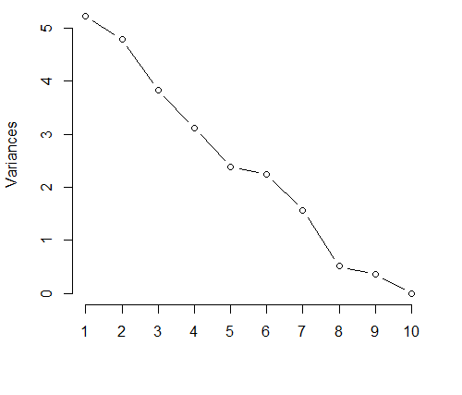
Goal: Conduct PCA on environmental variables to discern patterns of variation among the sites
Principle Component Axis | Standard deviation | Proportion of Variance | Cumulative Proportion
PC1 | 2.4957 | 0.2595 | 0.2595
PC2 | 2.2056 | 0.2027 | 0.4622
PC3 | 1.9068 | 0.1515 | 0.6137
PC4 | 1.7469 | 0.1272 | 0.7409
PC5 | 1.5634 | 0.1018 | 0.8427
PC6 | 1.32689 | 0.07336 | 0.91607
PC7 | 1.15941 | 0.05601 | 0.97208
PC8 | 0.65057 | 0.01764 | 0.98971
PC9 | 0.49691 | 0.01029 | 1
PC10 | 2.80E-15 | 0.00E+00 | 1.00E+00
Scree plot for PCA of sites and their environmental variables
Summary of PCA
Unlike most PCAs, this scree plot does not have an exponential decay. PC1 + PC2 only accounts for 41.69% of the variation among sites.

Slide 33
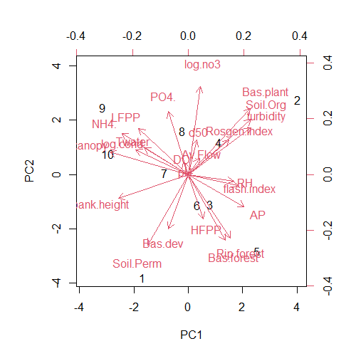
variable | PC1 | PC2
canopy | -0.80414 | 0.220828
bank.height | -0.71586 | -0.2356
NH4. | -0.68092 | 0.404682
log.cond | -0.53953 | 0.239143
LFPP | -0.50937 | 0.454223
Twater | -0.45219 | 0.261157
Soil.Perm | -0.41537 | -0.69273
PO4. | -0.20534 | 0.615143
Bas.dev | -0.2015 | -0.53301
DO | -0.05358 | 0.122313
pH | -0.02303 | 0.01263
d50 | 0.084812 | 0.336731
Av.Flow | 0.113341 | 0.160583
log.no3 | 0.122872 | 0.862227
HFPP | 0.152055 | -0.43224
Bas.forest | 0.376102 | -0.64802
Rosgen.Index | 0.418434 | 0.340295
Rip.forest | 0.43299 | -0.62211
RH | 0.463994 | -0.06327
flash.index | 0.508531 | -0.10762
AP | 0.572453 | -0.31467
Bas.plant | 0.635744 | 0.643684
turbidity | 0.639434 | 0.456038
Soil.Org | 0.640082 | 0.543809
variable | PC1 | PC2
Soil.Perm | -0.41537 | -0.69273
Bas.forest | 0.376102 | -0.64802
Rip.forest | 0.43299 | -0.62211
Bas.dev | -0.2015 | -0.53301
HFPP | 0.152055 | -0.43224
AP | 0.572453 | -0.31467
bank.height | -0.71586 | -0.2356
flash.index | 0.508531 | -0.10762
RH | 0.463994 | -0.06327
pH | -0.02303 | 0.01263
DO | -0.05358 | 0.122313
Av.Flow | 0.113341 | 0.160583
canopy | -0.80414 | 0.220828
log.cond | -0.53953 | 0.239143
Twater | -0.45219 | 0.261157
d50 | 0.084812 | 0.336731
Rosgen.Index | 0.418434 | 0.340295
NH4. | -0.68092 | 0.404682
LFPP | -0.50937 | 0.454223
turbidity | 0.639434 | 0.456038
Soil.Org | 0.640082 | 0.543809
PO4. | -0.20534 | 0.615143
Bas.plant | 0.635744 | 0.643684
log.no3 | 0.122872 | 0.862227
PCA of 10 sites with selected environmental variables
PCA correlations ordered by PCA1
PCA correlations ordered by PCA2
PCA1 has correlations greater than 0.6 with canopy, bank.height, NH4
PCA2 has correlations greater than 0.6 with Soil.Perm, Bas.forest, & Rip.forest
With only ten sample sites, 6 environmental variables to be assessed using linear regression include the top 3 covariates with PC1 and PC2: “canopy", “bank,height", “NH4", “Soil.Org", “Bas.forest", “Rip.forest”
Contrarily, I could investigate with a priori selected variables (AP, 2 hydrology, 2 watershed, 2 water quality, 1 habitat:
AP, LFPP, flash.index, Soil.Perm, Rip.forest, NH4, conductivity, Rosgen.Index

Slide 34

model | (Int) | AP | bnk.hgh | Bas.frs | cnp | NH4. | Rip.frs | Sol.Org df | logLik | AICc | delta | weight
2 | -0.336 | 0.01727 |  |  |  |  |  | 3 | -0.985 | 12 | 0 | 0.241
4 | 0.2589 | 0.01605 | -0.9008 |  |  |  |  | 4 | 1.461 | 13.1 | 1.11 | 0.138
6 | -0.3085 | 0.01554 |  | 0.0158 |  |  |  | 4 | 1.108 | 13.8 | 1.81 | 0.097
34 | -0.2682 | 0.01438 |  |  |  |  | 0.01817 | 4 | 0.984 | 14 | 2.06 | 0.086
10 | 0.2849 | 0.01314 |  |  | -0.00534 |  |  | 4 | 0.69 | 14.6 | 2.65 | 0.064
18 | 0.4036 | 0.01317 |  |  |  | -2.67 |  | 4 | 0.688 | 14.6 | 2.65 | 0.064
9 | 1.678 |  |  |  | -0.0093 |  |  | 3 | -2.622 | 15.2 | 3.27 | 0.047
17 | 1.889 |  |  |  |  | -4.647 |  | 3 | -2.642 | 15.3 | 3.31 | 0.046
33 | 0.9466 |  |  |  |  |  | 0.02858 | 3 | -3.34 | 16.7 | 4.71 | 0.023
1 | 1.261 |  |  |  |  |  |  | 2 | -5.592 | 16.9 | 4.93 | 0.02
# Precipitation is a predictor in the top 5 multivariate models and has the largest estimated slope compared to all other scaled environmental variables in the exhaustive multivariate regression.
# Positive predictors of fish diversity include Bas.forest and Rip.forest
# Negative predictors of fish diversity include bank height, canopy, and NH4+
Top ten dredge outputs for fish Shannon versus 7 PCA-selected environmental variables
model_name | var1 | estimate | var2 | estimate2 | adjusted_r2 | f.stat | df | p.value
fm3 | AP | 0.321722 | bank.height | -0.17679 | 0.6863 | 10.84493 | 3 | 0.007175
fm6 | AP | 0.311504 | Bas.forest | 0.168235 | 0.663337 | 9.866483 | 3 | 0.009187
fm34 | AP | 0.288174 | Rip.forest | 0.170771 | 0.654924 | 9.540603 | 3 | 0.010016
fm10 | AP | 0.263437 | canopy | -0.17147 | 0.633976 | 8.794285 | 3 | 0.012311
fm18 | AP | 0.264055 | NH4. | -0.17111 | 0.633851 | 8.790063 | 3 | 0.012325
Summary statistics for top five AICc ranked multivariate regression models for predicting fish Shannon index using 7 PCA-selected environmental variables

Slide 35
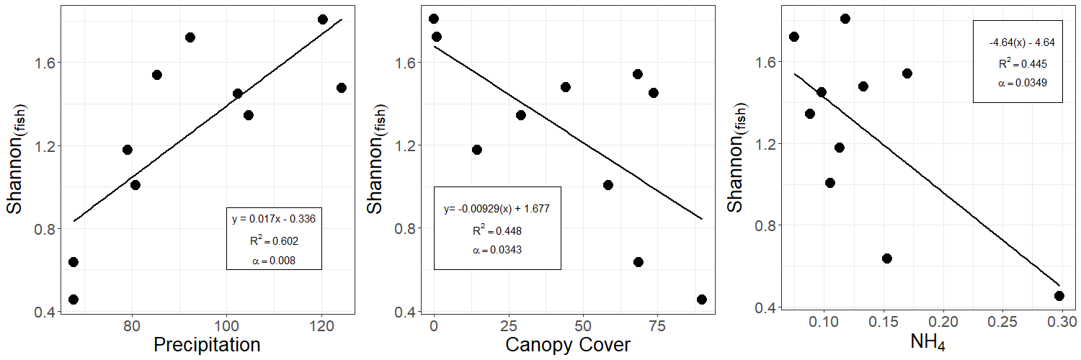
A
B
C
Above: Shannon diversity of fish communities plotted against (A) annual precipitation (cm/yr) (B) canopy coverage (%) and (C) NH4+ (mg/L).
predictor | estimate | df | r2 | f.stat | p.value
AP | 0.017271 | 2 8 | 0.602017 | 12.10136 | 0.008336
Bas.forest | 0.021825 | 2 8 | 0.271423 | 2.980307 | 0.122558
Soil.Org | 0.276431 | 2 8 | 0.121132 | 1.102616 | 0.324376
Rip.forest | 0.028585 | 2 8 | 0.362586 | 4.550714 | 0.065462
bank.height | -1.12768 | 2 8 | 0.246026 | 2.610439 | 0.144825
canopy | -0.0093 | 2 8 | 0.447887 | 6.489777 | 0.034308
NH4. | -4.64708 | 2 8 | 0.445651 | 6.431349 | 0.034927
3 statistically significant regressions :
+ precipitation
- canopy
- NH4
Linear regression statistics for fish Shannon diversity against PCA-selected variables

Slide 36
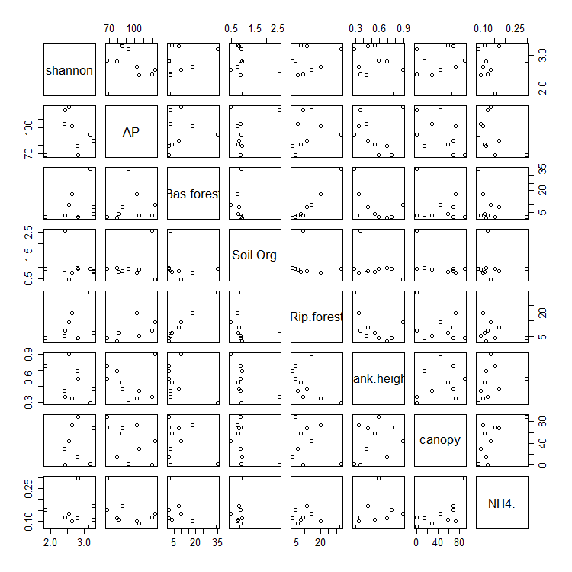

predictor | estimate | df | r2 | f.stat | p.value
AP | -0.00302 | 2 8 | 0.01736 | 0.141333 | 0.716733
Bas.forest | 0.016587 | 2 8 | 0.147817 | 1.38766 | 0.272652
Soil.Org | -0.17543 | 2 8 | 0.046001 | 0.385754 | 0.551821
Rip.forest | 0.01767 | 2 8 | 0.130638 | 1.202154 | 0.304796
bank.height | -0.8301 | 2 8 | 0.125697 | 1.150145 | 0.314801
canopy | -0.00022 | 2 8 | 0.000243 | 0.001946 | 0.965892
NH4. | -0.06524 | 2 8 | 8.28E-05 | 0.000662 | 0.980096
Above: Regression statistics for invertebrate Shannon index versus PCA-selected environmental predictors
Left: Pairs plots for invertebrate diversity and environmental variables
No significant correlations with invertebrate diversity

Slide 37
model | (Int) | AP | bnk.hgh | Bas.frs | cnp | NH4. | Rip.frs | Sol.Org | df | logLik | AICc | delta | weight
1 | 2.727 |  |  |  |  |  |  |  | 2 | -5.886 | 17.5 | 0 | 0.397
5 | 2.727 |  |  | 0.1767 |  |  |  |  | 3 | -5.086 | 20.2 | 2.69 | 0.104
33 | 2.727 |  |  |  |  |  | 0.1661 |  | 3 | -5.186 | 20.4 | 2.89 | 0.094
3 | 2.727 |  | -0.1629 |  |  |  |  |  | 3 | -5.215 | 20.4 | 2.94 | 0.091
65 | 2.727 |  |  |  |  |  |  | -0.09855 | 3 | -5.651 | 21.3 | 3.81 | 0.059
2 | 2.727 | -0.06054 |  |  |  |  |  |  | 3 | -5.799 | 21.6 | 4.11 | 0.051
9 | 2.727 |  |  |  | -0.00717 |  |  |  | 3 | -5.885 | 21.8 | 4.28 | 0.047
17 | 2.727 |  |  |  |  | -0.00418 |  |  | 3 | -5.886 | 21.8 | 4.28 | 0.047
67 | 2.727 |  | -0.2427 |  |  |  |  | -0.1969 | 4 | -4.25 | 24.5 | 7.01 | 0.012
Top ten AICc ranked multivariate regressions for invertebrate Shannon index using 7 PCA-selected variables
model_name | var1 | estimate | var2 | estimate2 | adjusted_r2 | f.stat | df | p.value
im67 | bank.height | -0.24268 | Soil.Org | -0.19688 | 0.073198 | 1.355403 | 3 | 0.318016
10th AICc-ranked multivariate regression predicting invertebrate Shannon index
# 9/10 top AICc models contained one or fewer environmental predictors. Previous univariate regressions indicate no statistically significant correlations
# Invertebrate model 67 indicates bank height and soil organic content as negative predictors of invertebrate shannon index. However, the p value for the model is 0.318 and the correlation coefficient is 0.073. So this multivarite regression is neither accurate nor statistically significant.
# Regression analysis fails to provide useful environmental predictors for stream macroinvertebrate diversity in this survey.

